Slide 1
HTML DEFINATION AND TAGS
Name : Vaishnavi Verma
Enrollment No. :- 2404030400006
Branch : BSc CS IT
Division : A

Slide 2
HtML (HYPER tEXt MARKUP LANGUAGE)
HTML stands for Hyper Text Markup Language
HTML is the standard markup language for creating Web pages
HTML describes the structure of a Web page
HTML consists of a series of elements
HTML elements tell the browser how to display the content
HTML elements label pieces of content such as "this is a heading", "this is a paragraph", "this is a link", etc.

Slide 3
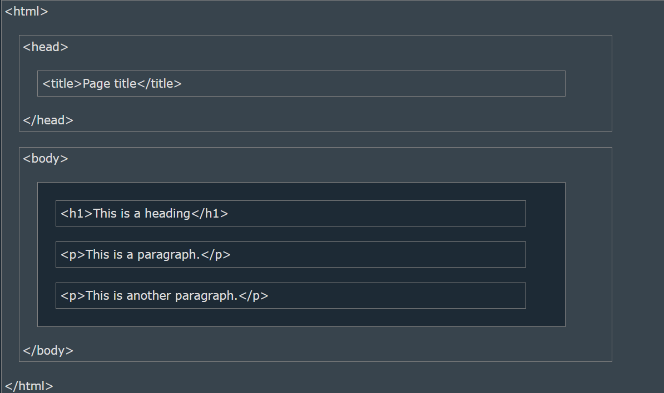
HTML Page Structure

Slide 4
HTML Basic tags
HTML Documents :
All HTML documents must start with a document type declaration: <!DOCTYPE html>.
The HTML document itself begins with <html> and ends with </html>.
The visible part of the HTML document is between <body> and </body>.
The <!DOCTYPE> Declaration :
The <!DOCTYPE> declaration represents the document type, and helps browsers to display web pages correctly.
The <!DOCTYPE> declaration is not case sensitive.
The <!DOCTYPE> declaration for HTML 5 .

Slide 5
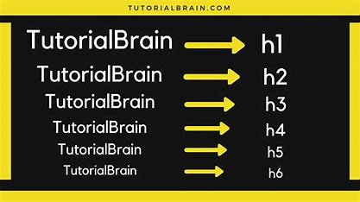
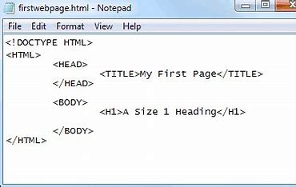
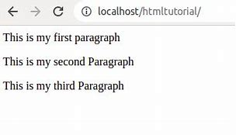
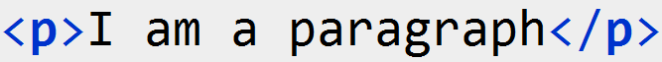
HTML Heading
HTML headings are defined with the <h1> to <h6> tags.
Syntax :
<h1> defines the most important heading. <h6> defines the least important heading .
Proper use of headings helps improve readability, SEO, and accessibility.
HTML Paragraph
HTML paragraphs are defined with the <p> tag.
Syntax :
A paragraph in HTML is simply a block of text enclosed within the <p> tag.
The <p> tag helps divide content into manageable, readable sections.

Slide 6
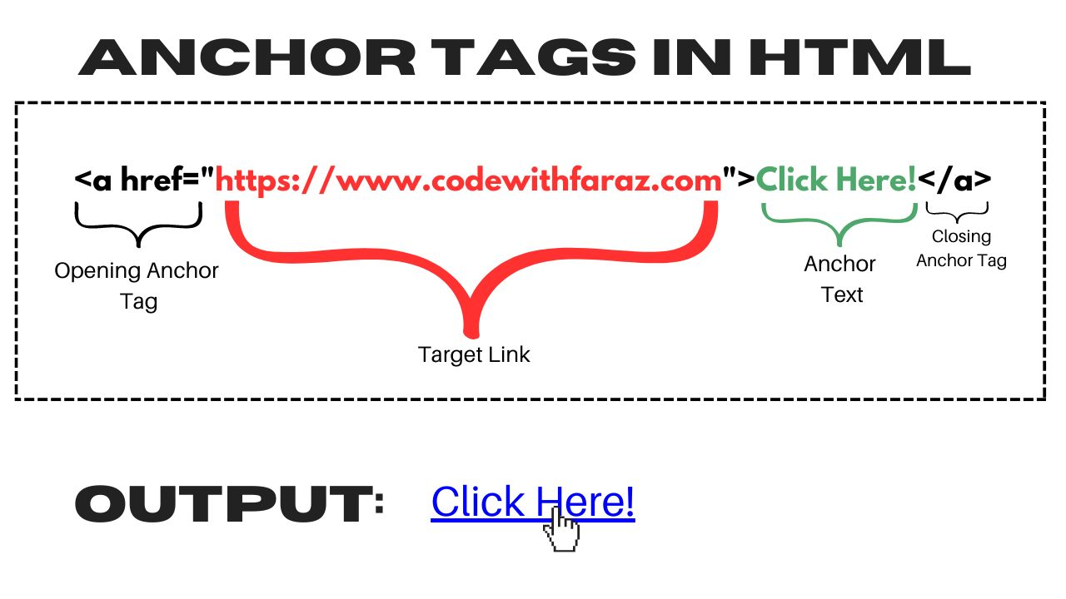
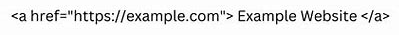
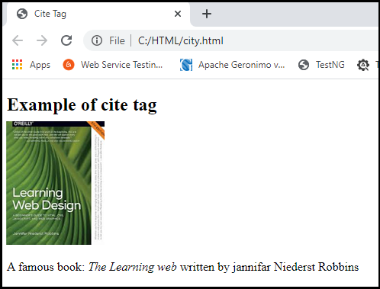
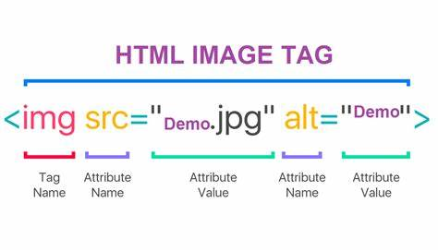
HTML Links
HTML Links, also known as hyperlinks, are defined by the <a> tag in html, which stands for “anchor.”
Syntax :
These links are essential for navigating between web pages and directing users to different sites, documents, or sections within the same page.
The basic attributes of the <a> tag include href, title, and target, among others.
HTML Images
HTML images are defined with the <img> tag.
Syntax :
The source file (src), alternative text (alt), width, and height are provided as attributes.

Slide 7
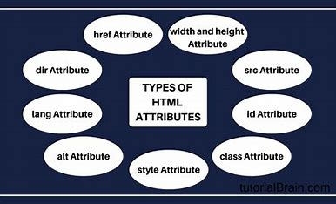
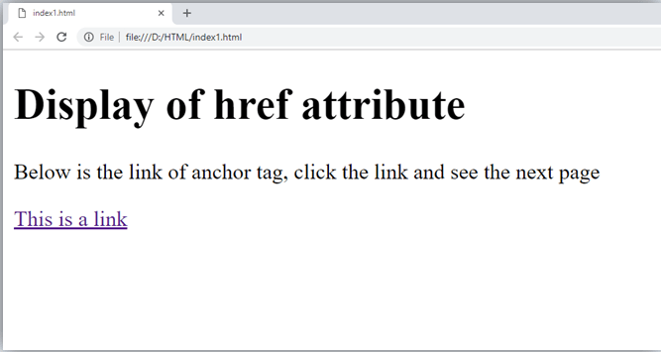
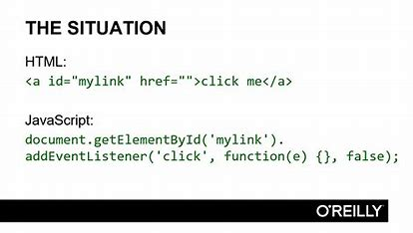
HTML Attribute :
All HTML elements can have attributes.
Attributes provide additional information about elements.
Attributes are always specified in the start tag.
Attributes usually come in name/value pairs like: name="value“.
The Href Attribute :
The <a> tag defines a hyperlink. The href attribute specifies the URL of the page the link goes .
Syntax :
Absolute URL : It points to another website.
Relative URL : It points to a file within a website.
Anchor URL : It points to an anchor within a page.

Slide 8
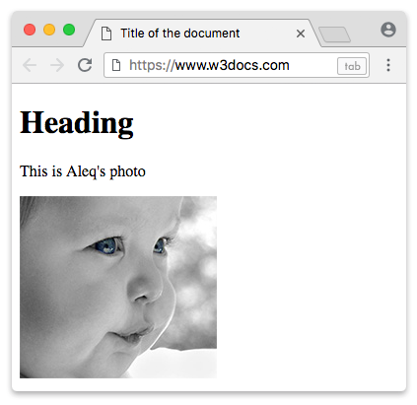
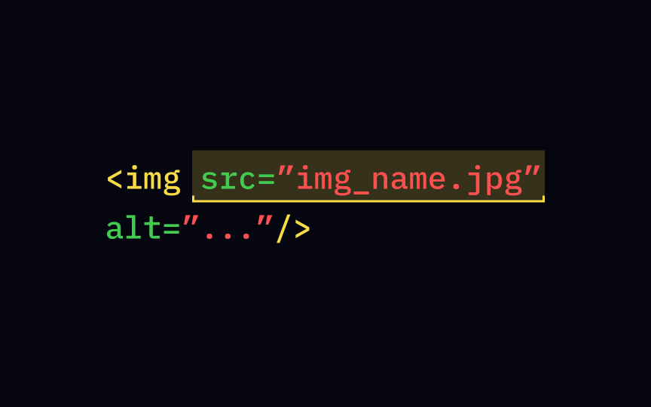
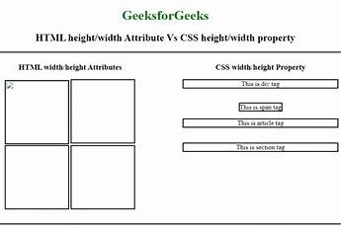
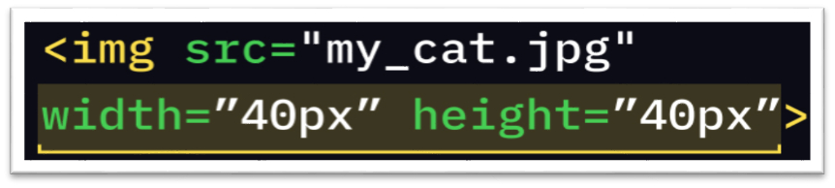
The SRC Attribute
The <img> tag is used to embed an image in an HTML page. The src attribute specifies the path to the image to be displayed.
Syntax :
The Width And Height Attributes
The <img> tag should also contain the width and height attributes, which specify the width and height of the image (in pixels).
Syntax :

Slide 9
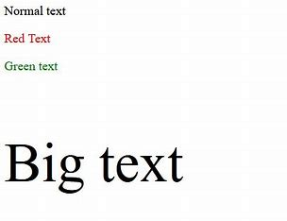
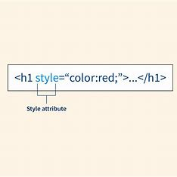
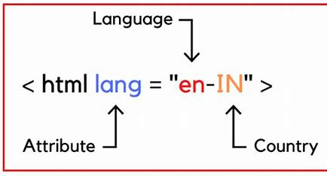
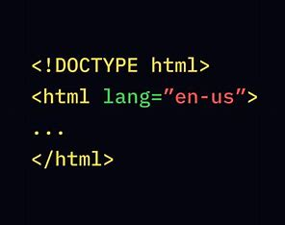
The Style Attribute :
The style attribute is used to add styles to an element, such as color, font, size, and more.
Syntax :
The Lang Attribute :
You should always include the lang attribute inside the <html> tag, to declare the language of the Web page. This is meant to assist search engines and browsers.
Syntax :

Slide 10
THANKYOU

